Slide 1
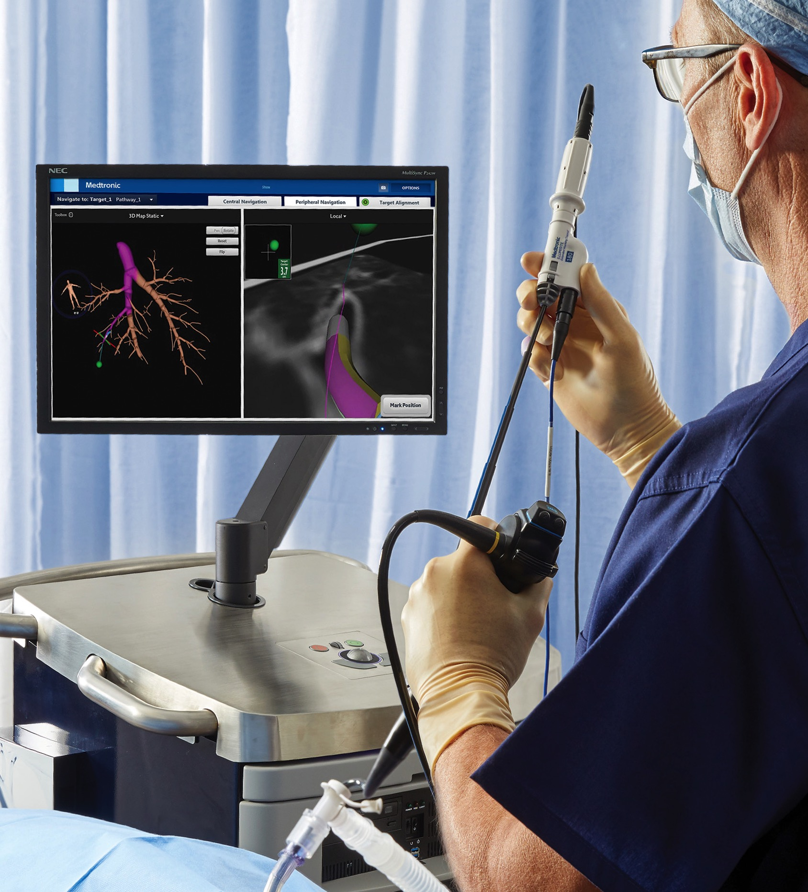


Put the
Power of
precision
In your hands
ILLUMISITE™ Platform

Slide 2
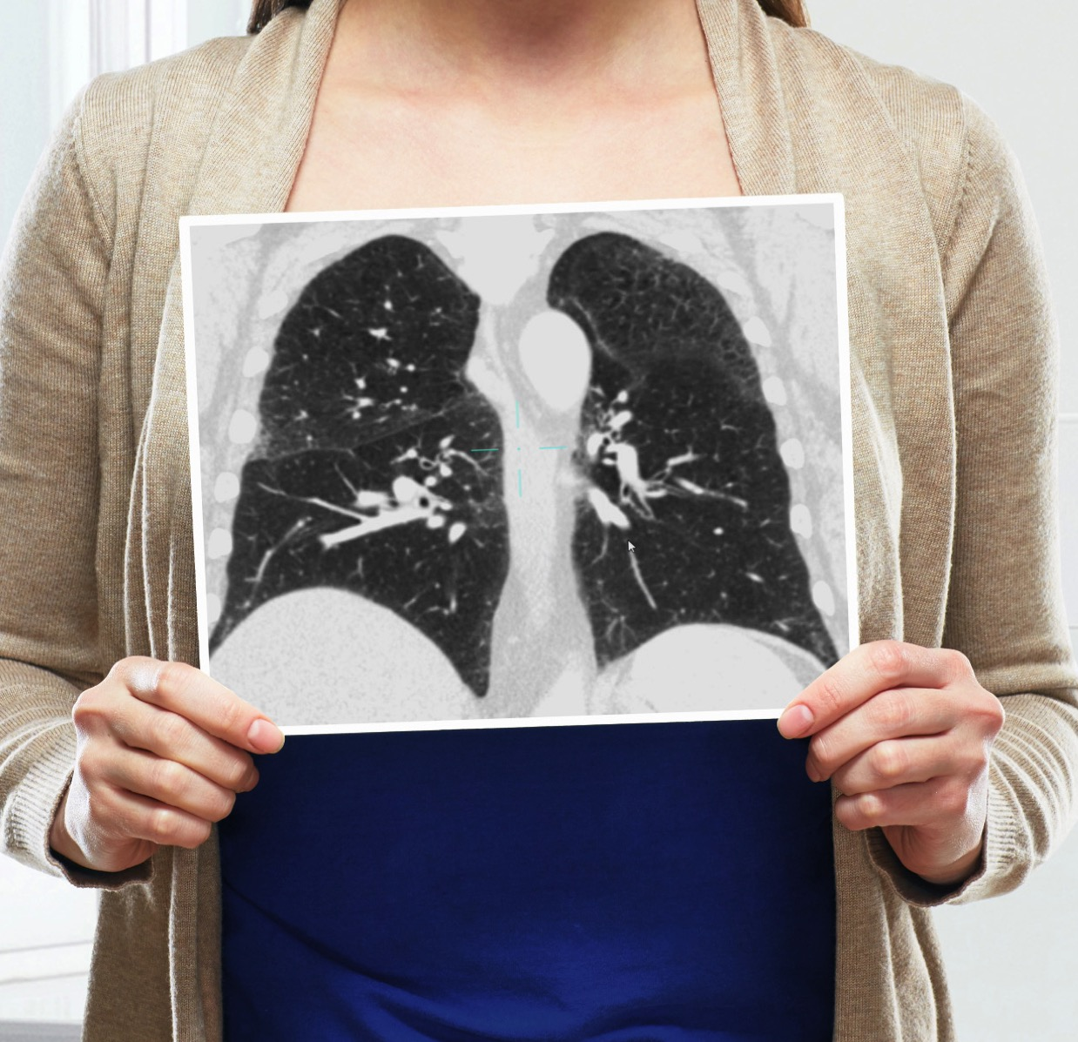
ACCURACY
IS EVERYTHING
Reliance on a static image in a dynamic environment can make nodule biopsies using lung navigation technology challenging.
CT-to-body divergence — the discrepancy between the static pre-op CT scan and the dynamic breathing lung — can affect accuracy and biopsy location, regardless of navigation technology.¹
You need confidence throughout the procedure to know where you’re at, and that you’re on target.
Top causes of
CT-to-body divergence:
Static CT image in dynamic lung environment
Changes from anesthesia
Tissue distortion due to robotic and flexible scopes

Slide 3
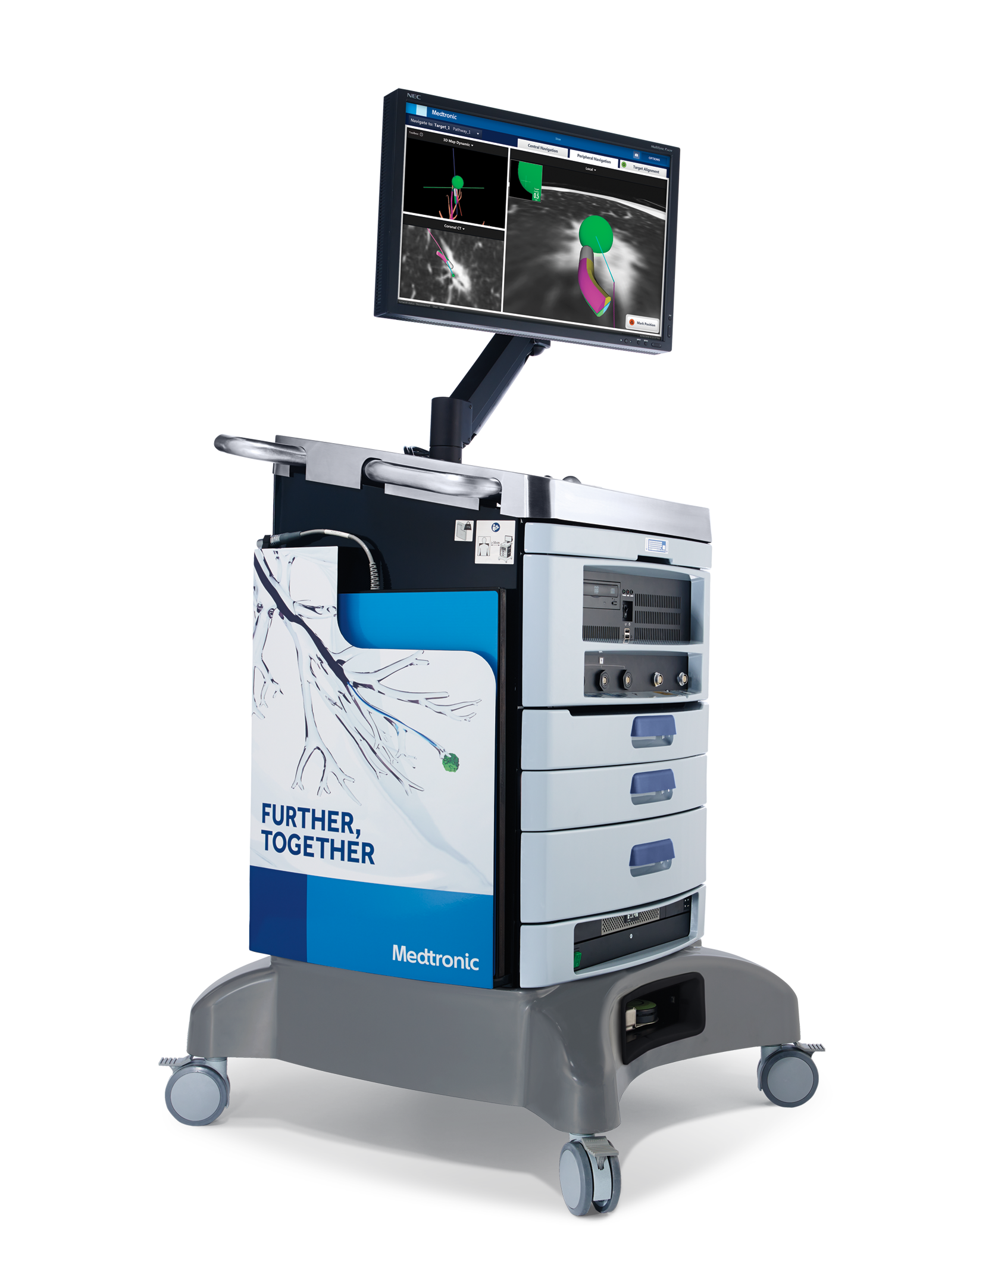
YOUR VISION
IS NOW A REALITY
Introducing the ILLUMISITE™ Platform
Fluoroscopic navigation technology corrects for
CT-to-body divergence by visually enhancing nodules, and allowing alignment of the catheter to the nodule during the procedure.^{1, 2} This enables you to be in the correct location prior to biopsy.
Continuous guidance helps you maintain alignment to the target — even after the locatable guide is removed, giving you confidence throughout the biopsy to sample multi-directionally. You can even reach nodules outside the airways with the CrossCountry™ transbronchial access tool.
Welcome to a new era in lung navigation.

Slide 4
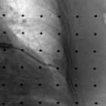
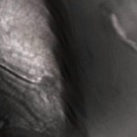
FluOroscopic
Navigation
technology
Perform local registration with 3D tomosynthesis-like input from an existing C-arm and enhance the nodule’s visibility. Adjust for CT-to-body divergence with alignment of the catheter to the nodule throughout the procedure.
Using fluoroscopic navigation technology, compare the 2D fluoroscopic image (top) to a slice of the 3D reconstruction of the exact same nodule (bottom).

Slide 5
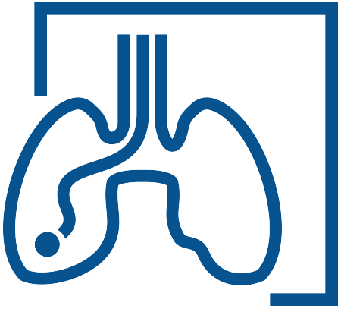
95% success rate‡ of the virtual target overlapping the actual after using fluoroscopic navigation technology²
Using fluoroscopic navigation
technology resulted in a nearly
The steerable catheter dimension is the same, but now features a sensor coil embedded in the distal tip. This generates continuous positional data, so you can maintain alignment on the target even after the locatable guide is removed.
25
Point increase†
in diagnostic yields¹
before
after
†25 percentage point increase using fluoroscopic navigation (79%, 53/67)
versus standard navigation (54%, 55/101)
‡Cases with evaluable videos (n=41)

Slide 6
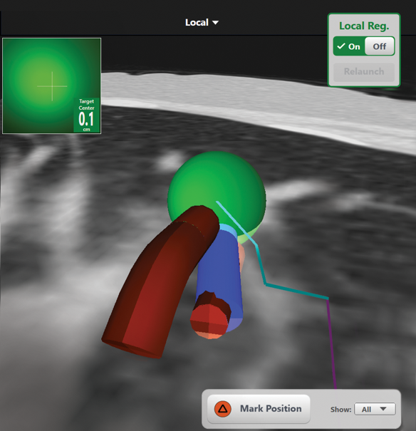
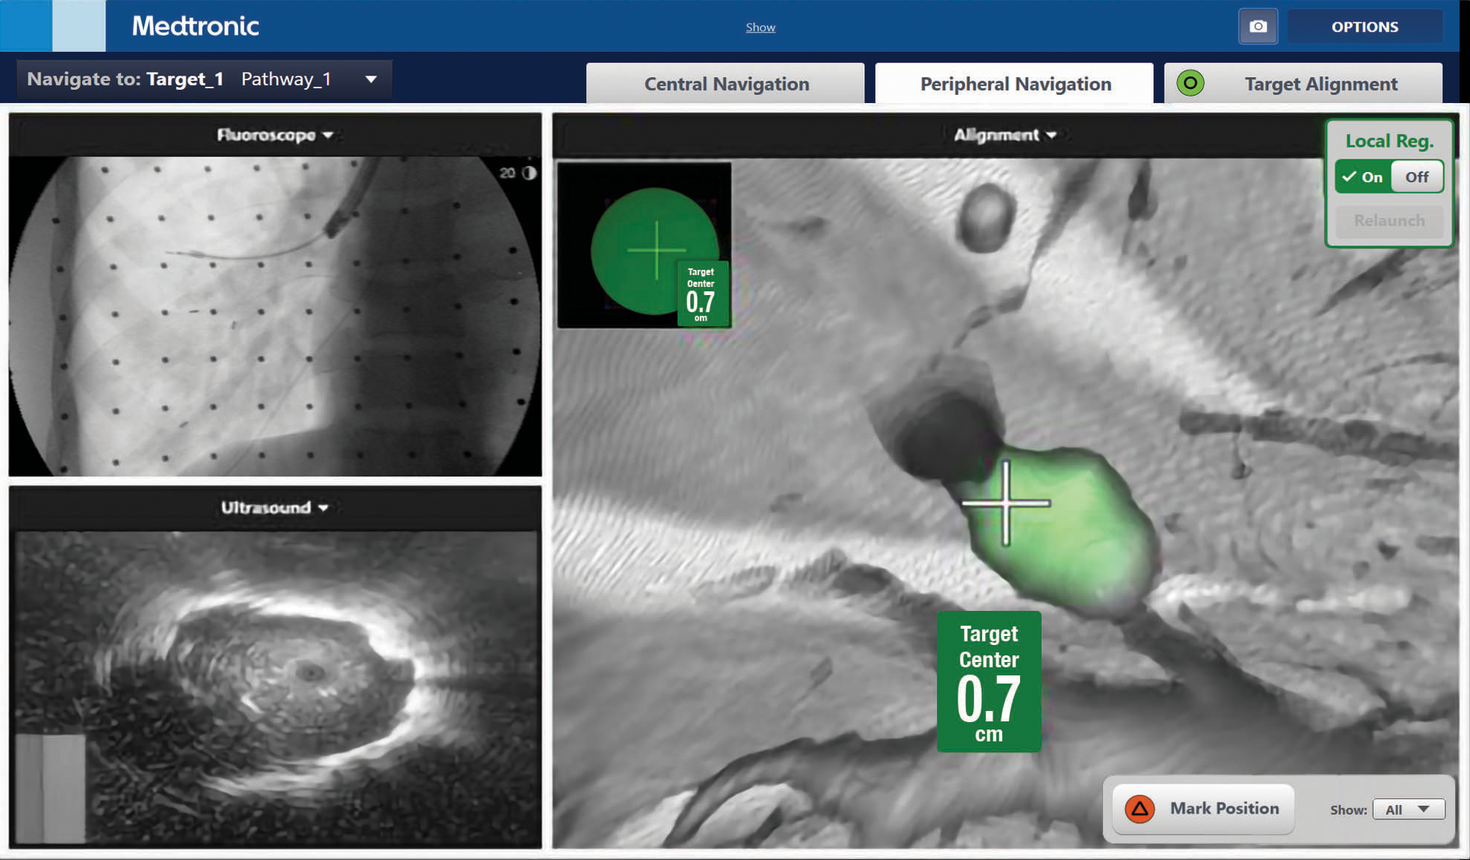
continuous
guidance
The sensor embedded in the catheter tip provides positional data, so you can maintain alignment to the target even after the locatable guide is removed. Sample multi-directionally for a thorough biopsy and potentially improved procedural outcomes.
Mark your position
in the local view to facilitate multi-directional sampling.
With the locatable guide removed, radial ebus confirms successful navigation to the nodule. Continuous guidance shows the alignment to the nodule.

Slide 7
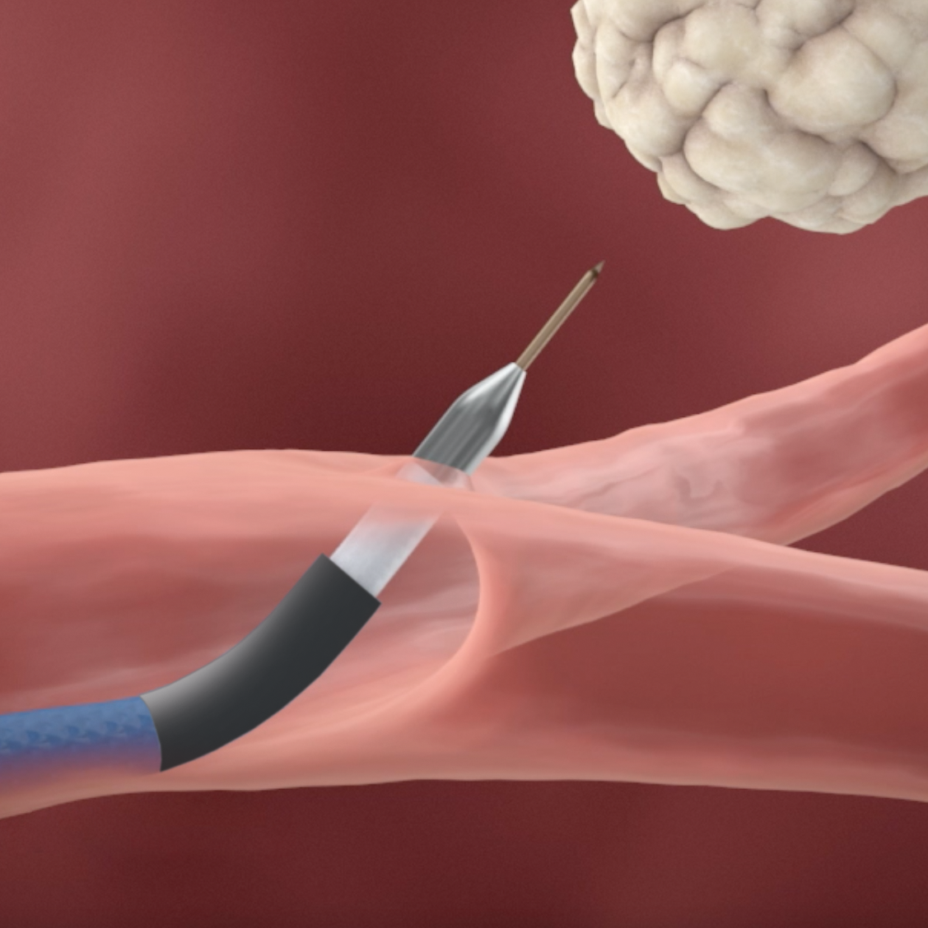
Travel outside
the airways
The CrossCountry™ transbronchial access tool is designed to allow access to lung nodules outside an airway. In one study, clinicians reported that more than 50% of nodules are not located in a visible airway.³
Extend the reach of bronchoscopy with the CrossCountry™ transbronchial access tool.

Slide 8
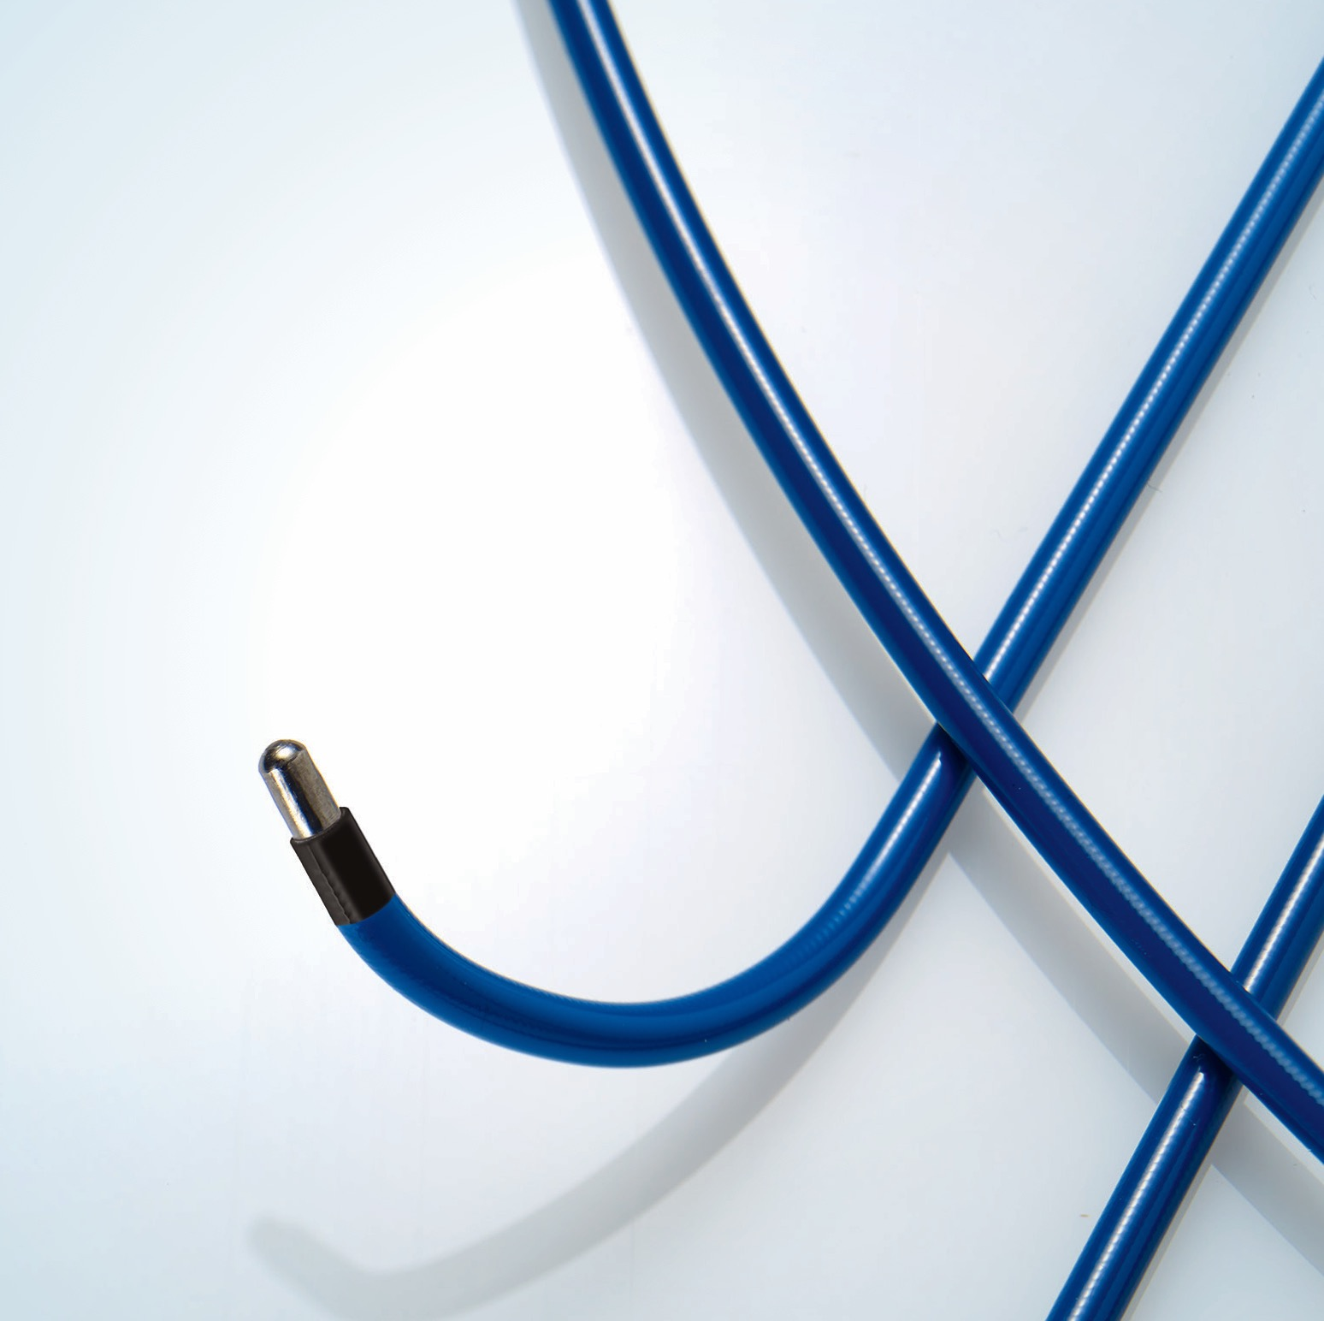
Innovative
tools
For optimized Procedures
Sensing Catheters
A sensor embedded in the distal tip generates continuous positional data, so you can maintain alignment on the target even after the locatable guide is removed.

Slide 9
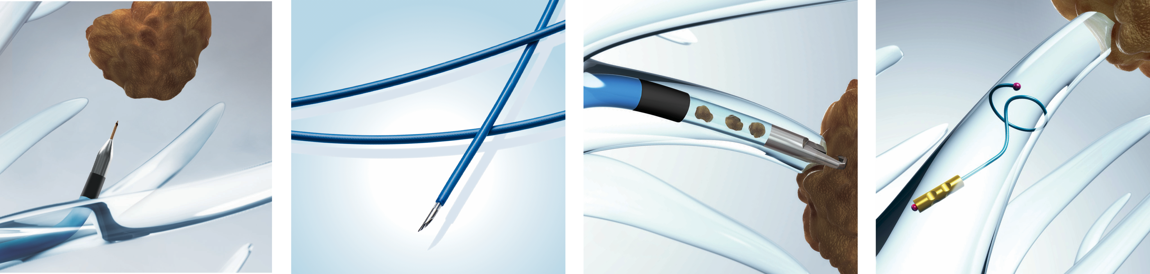
CrossCountry™
Arcpoint™
GenCut™
SuperLock™
Transbronchial Access Tool
Pulmonary Needle
Core Biopsy System
Nitinol Coil Fiducial Markers
Now you can access nodules outside an airway. This tool is designed to extend the reach of bronchoscopy and enable more patients to benefit from navigation procedures.
Features a braided sheath for trackability and maneuverability that is tapered for ease of sampling. The short, rigid metal needle maximizes flexibility. There is also an optional stylet for additional rigidity if needed.
Using a proprietary blade design, this tool was designed to obtain core tissue samples for molecular genetic analysis and enable continuous sampling.
With shape memory designed to secure the marker and minimize migration, these markers conform to the contours of the anatomy and enable nodule localizing during stereotactic body radiation therapy (SBRT/XBRT).

Slide 10

Together,
we can
Do more
For lung
cancer care
At Medtronic, we have a passion for evolving lung cancer care — from innovative surgical products to minimally invasive techniques.
But that’s just the beginning.
We have also created lung cancer programs that address the entire care continuum. We believe that powerful partnerships will help transform lung cancer from a deadly disease into a managed condition.
Learn more at illumisite.com.

Slide 11
References
1. Bhadra K, Mattingley J, Pritchett M. Electromagnetic navigation bronchoscopy with advanced fluoroscopy-based localization and intraprocedural local registration for the evaluation of peripheral pulmonary nodules. Paper presented at: CHEST Annual Meeting; October 23, 2019; New Orleans, LA.
2. Aboudara M, Roller L, Rickman O, et al. Improved diagnostic yield for lung nodules with digital tomosynthesis-corrected navigational bronchoscopy: Initial experience with a novel adjunct. Respirology. 2019 July 2. doi:10.1111/resp.13609. [Epub ahead of print]
3. Folch E, Khandhar S, et al. Electromagnetic navigation bronchoscopy for peripheral pulmonary lesions: one-year results of the prospective, multicenter NAVIGATE study. J Thorac Oncol. 2019; 14(3): 445-458.

Slide 12
ILLUMISITE™ Platform - Indications for Use
Indicated for displaying images of the tracheobronchial tree to aid the physician in guiding endoscopic tools or catheters in the pulmonary tract and to enable marker placement within soft lung tissue. It does not make a diagnosis and is not an endoscopic tool. Not for pediatric use.
The ILLUMISITE™ endobronchial procedure kit (which contains the locatable guide and extended working channel) shares the ILLUMISITE™ platform indications for use (see above).
Arcpoint™ Pulmonary Needle - Indications for Use
The Arcpoint™ pulmonary needle is utilized through a flexible endoscope or with the superDimension™ navigation system by physicians who are trained in endoscopic techniques for retrieving specimens from patients with endobronchial lesions, peripheral lung nodules, or lung masses.
GenCut™ Core Biopsy System - Indications for Use
The GenCut™ core biopsy system is utilized through a flexible endoscope or with the superDimension™ navigation system by physicians who are trained in endoscopic techniques for retrieving specimens from patients with endobronchial lesions, peripheral lung nodules, or lung masses.
SuperLock™ Fiducial Marker - Indications for Use (US)
The SuperLock™ fiducial marker is intended to be used to radiographically mark soft tissue for future surgical or therapeutic purposes.
SuperLock™ Fiducial Marker - Indications for Use (EU)
The SuperLock™ fiducial marker is intended to be used to radiographically mark soft lung tissue for future surgical or therapeutic purposes.
CrossCountry™ Transbronchial Access Tool - Indications for Use (EU)
The CrossCountry™ transbronchial access tool is to be utilized through a flexible endoscope with an extended working channel by physicians who are trained in endoscopic techniques to puncture the tracheobronchial wall and facilitate access of additional endobronchial tools for patients with endobronchial lesions, peripheral lung nodules, or lung masses.
Please see package insert for the complete list of indications, warnings, precautions, and other important medical information.
©2019 Medtronic. All rights reserved. Medtronic, Medtronic logo and Further, Together are trademarks of Medtronic. All other brands are trademarks of a Medtronic company.
10/2019 – US191005

Slide 13

Thank you

